Slide 1
A Helpline for veterans and their Loved ones
844-645-6261

Slide 2

Because…
.
Families Serve Too!

Slide 3
Have a question about Loved Ones that Served ?
We Can Help

Slide 4
Do you have a problem & your Loved One is Serving Overseas?
WE
CAN HELP

Slide 5
Veterans
Do You Know…
The Benefits
Your Entitled To?
We Can Help!

Slide 6
Need Help Talking to The NJ Department of Military Affairs
We Can Help

Slide 7
Need Help Talking to The VA
We Can Help

Slide 8
The Military Veteran Peers for Families Helpline
Is…
Here to Help!

Slide 9
Military Veteran Peer for Families (MVP)
is dedicated to providing peer support to families of Veterans in the following: Essex, Morris, and Union Counties.
The personnel are committed to working with family members who are watching their loved one suffer from a physical injury, mental illness or stressors associated with readjustment to civilian society from military.

Slide 10
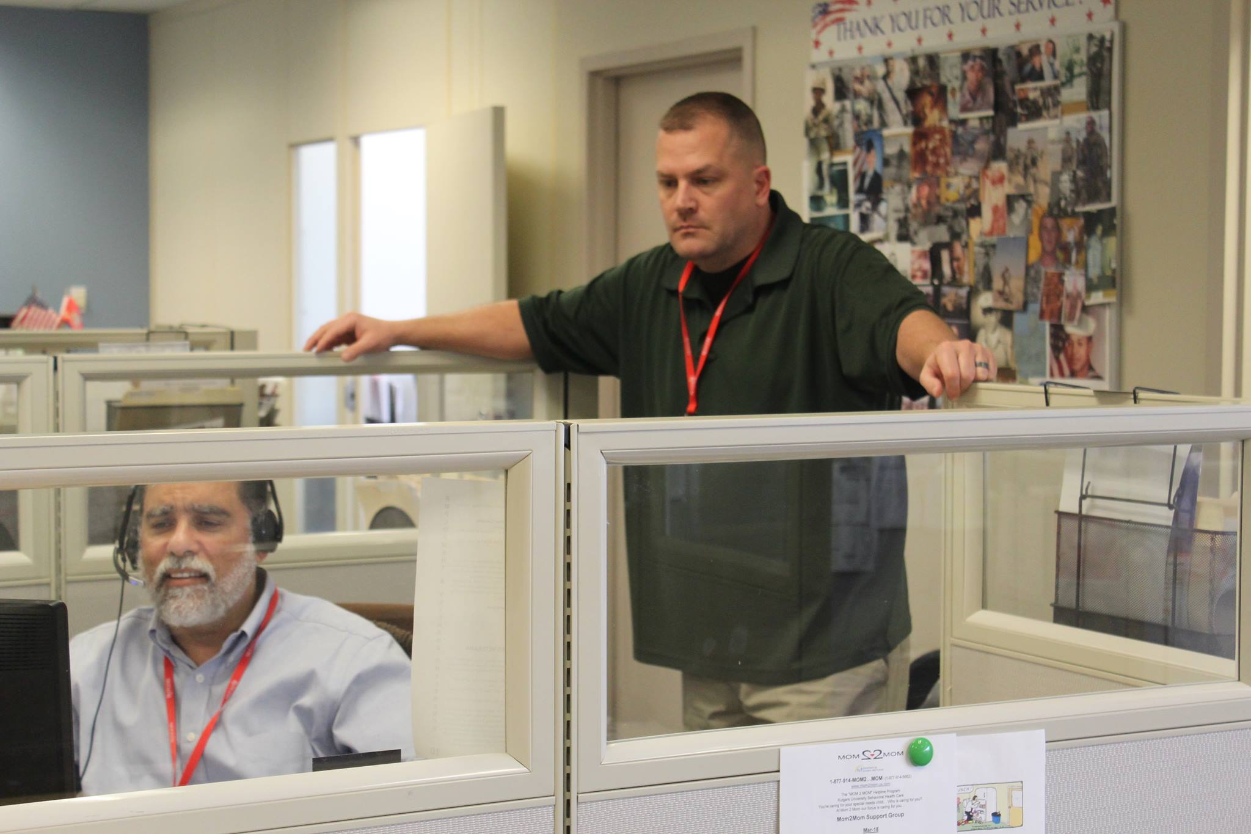
Questions??
Give Us a Call
We are veterans that understand
Notes:
Give Us a Call

Slide 11
We Are Here to Help

Slide 12
Military Veteran Peers for Families Helpline
844-645-6261

Slide 13
Because…
.
Families Serve Too!

Slide 14
Give us a call
WE CAN HELP
844.645.6261

